Slide 1
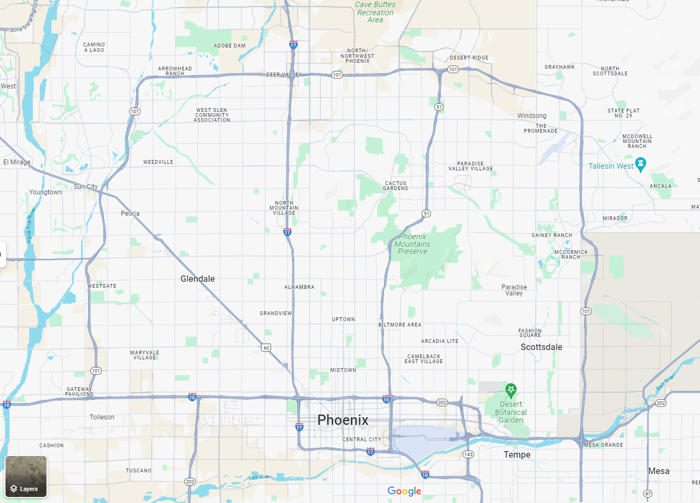
ORB ROADMAP
ORB University
ORB UNIVERSITY – February 21ST, 2024 PRESENTED BY Andres Fernandez
Notes:
TAKE A LOOK AT WHAT IS COMING DOWN THE LINE. SEVERAL PROJECTS ARE ABOUT TO COME AND WE HAVE BEEN PREPARING FOR THEM

Slide 2
UPCOMING PROJECTS:
DEER VALLEY EAST
TOLL MAZA II
INDIAN SCHOOL
56TH STREET & WASHINGTON
CHRISTOWN
ARROWHEAD
GOODYEAR
Notes:
AT LEAST 5 PROJECTS TO COME IN FOR PRODUCTION AND TWO ARE IN ZONING STAGES

Slide 3
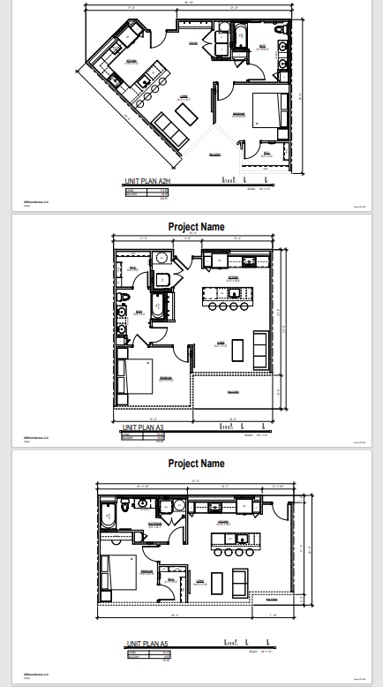
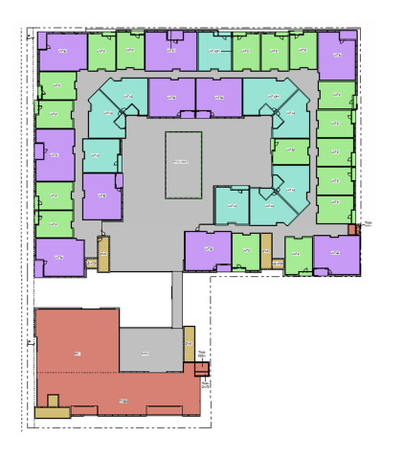
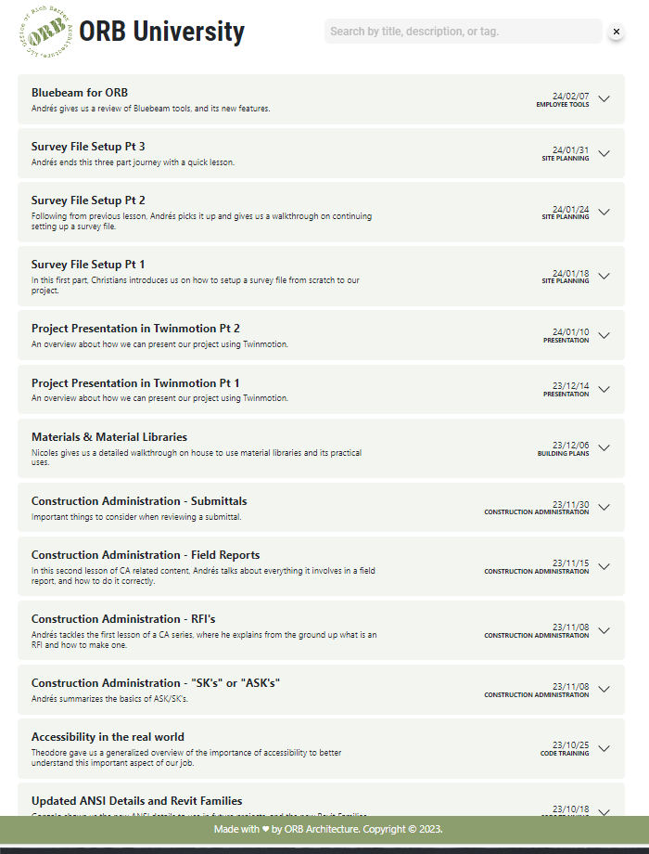
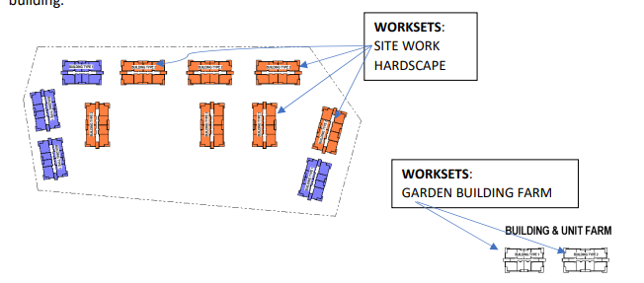
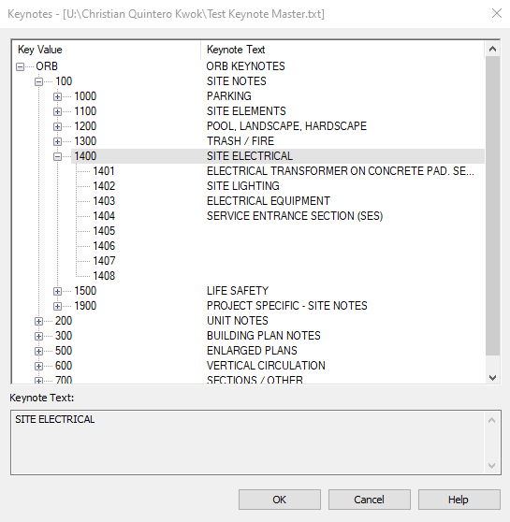
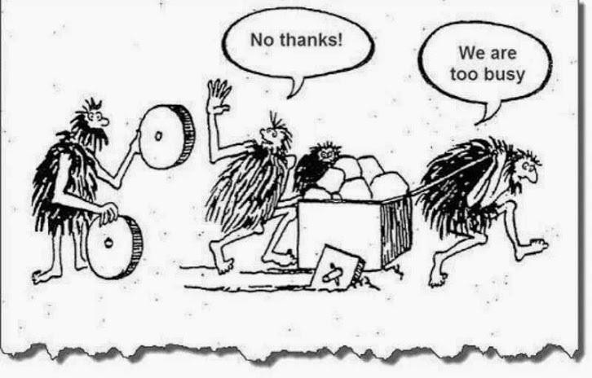
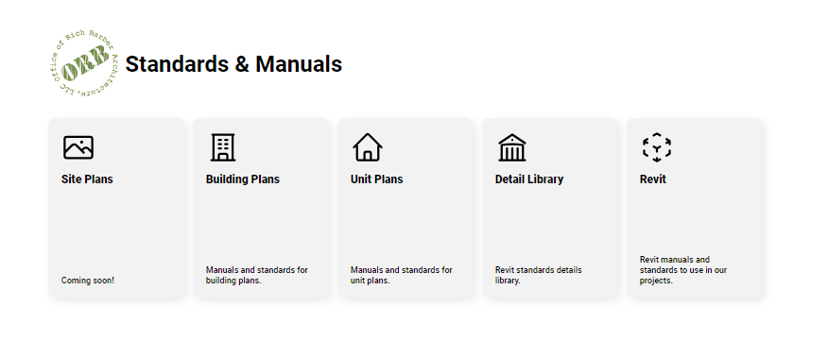
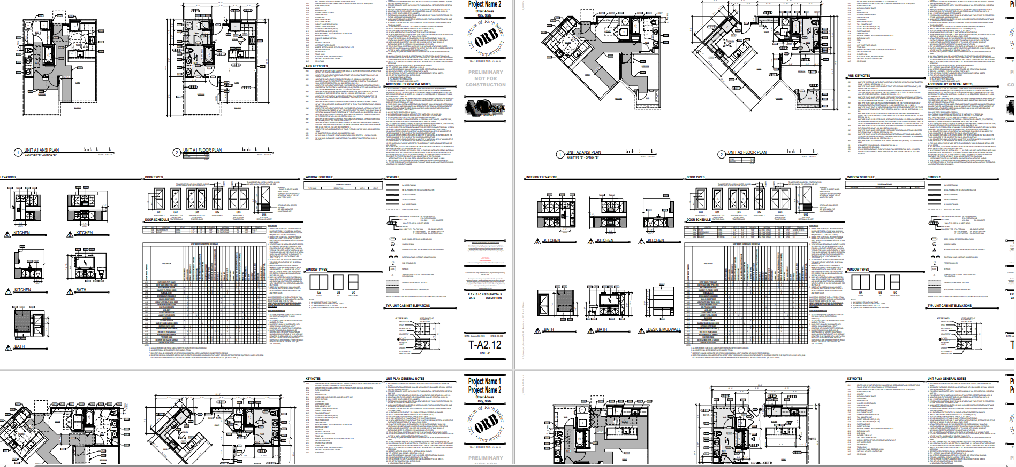
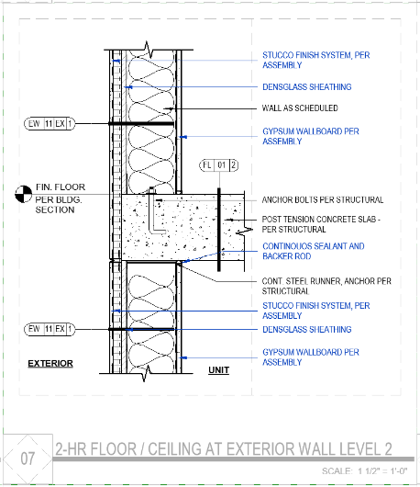
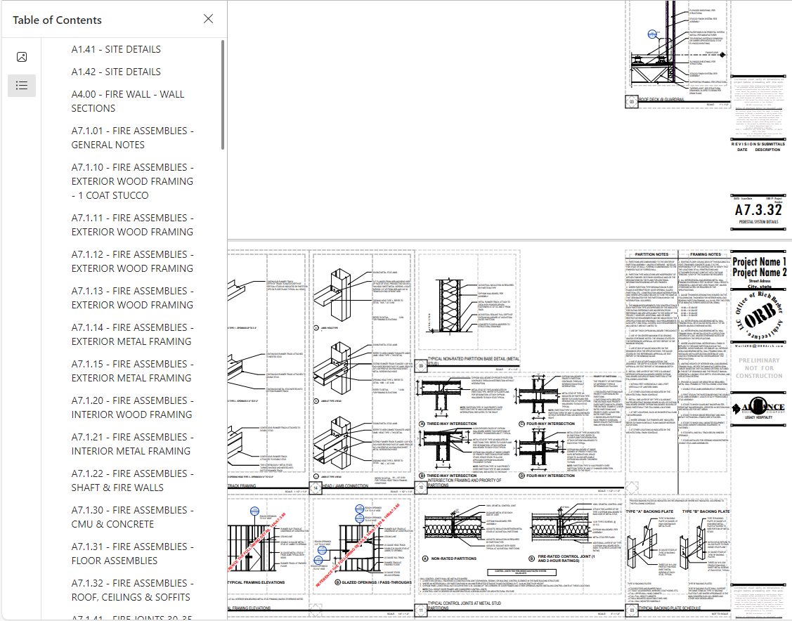
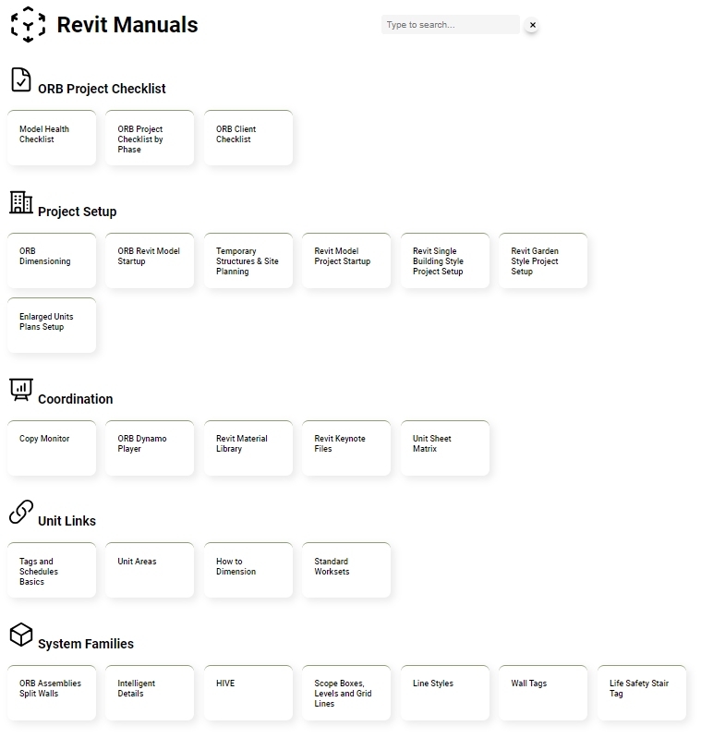
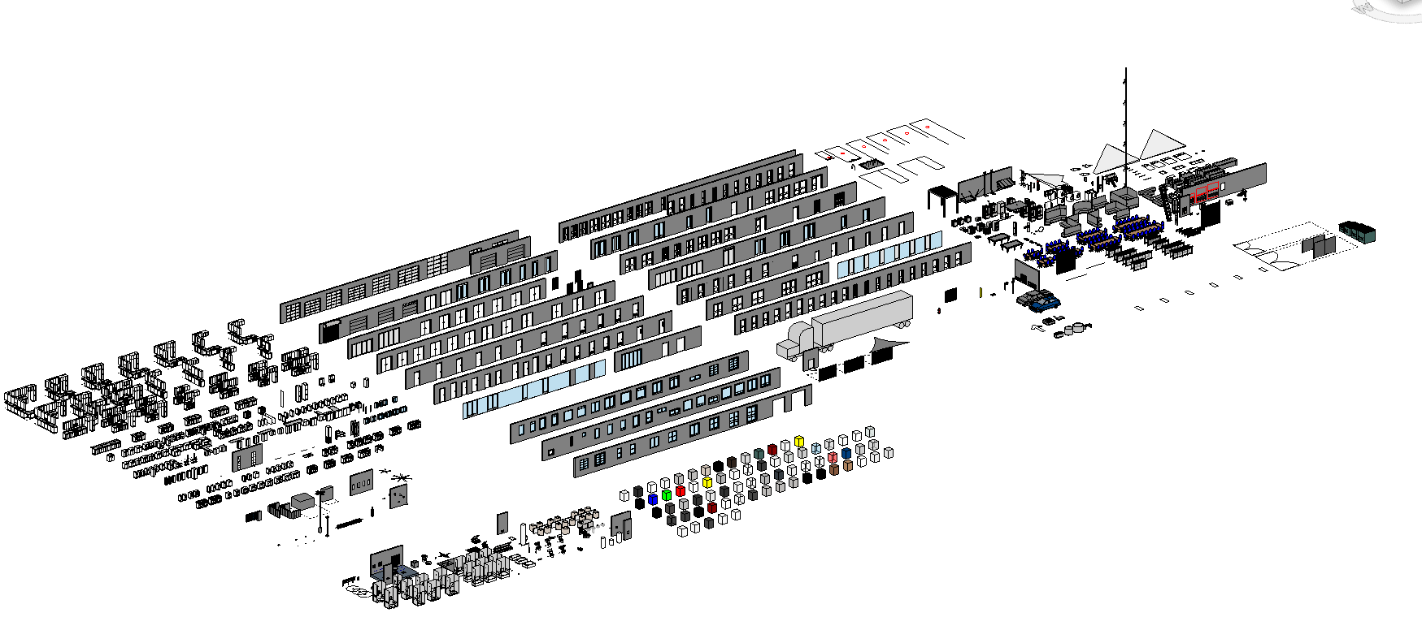
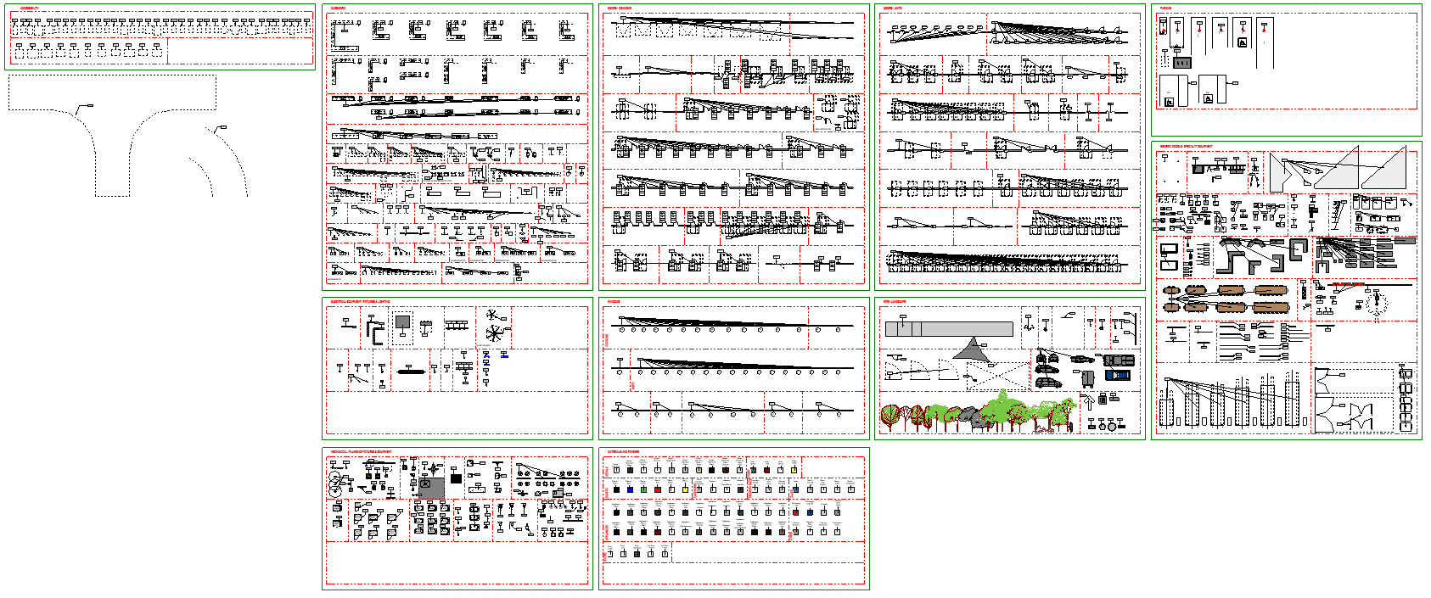
ORB HUB
ORB UNIVERSITY
REVIT UNIVERSITY
ORB MANUALS
Notes:
ORB HAS BEEN WORKING AND PREPARING FOR FUTURE PROJECTS.
WE MADE USE OF THE TIME WE DON’T TYPICALLY HAVE TO MAKE THE NECESSARY IMPROVEMENTS AND SYSTEM REPAIRS

Slide 4
ORB HUB
ORB UNIVERSITY
REVIT UNIVERSITY
ORB MANUALS
Notes:
THE BIGGEST RESOURCE IS THE IMPLEMENTATION OF THE HUB. ORB UNIVERISTIES, MANUALS AND MORE ORB INFORMATION IS CONSOLIDATED HERE. THE HUB IS AVAILABLE ONLINE (NOT JUST INSIDE THE OFFICE) – SPEARHEADED BY MIGUEL

Slide 5
ORB REVIT UPDATES
SITE TOOLS
TEMPORARY STRUCTURES
Notes:
WE HAVE DONE UPGRADES TO OUR SITE TOOLS. WE HAVE REDUCED THE TURNAROUND TIMES ON SITE PLANS WHILE PROVIDING UPDATED INFORMATION IN REAL TIME

Slide 6
ORB REVIT UPDATES
UNIT CATALOGUE
Notes:
THE ORB REVIT TEMPLATE IS NOW PRE-LOADED WITH THE UNIT CATALOGUE. TYPICAL UNIT MODELS, SHEETS AND INFORMATION IS ALREADY SET. AFTER DDs WHEN THE UNIT MIX IS SUPPOSED TO STAY, WE DELETE THE NON-REQUIRED UNITS AND SHEETS. THE OTHERS ARE ALREADY SET ON SHEETS, NOTED AND DIMENSIONED CORRECTLY, THEREFORE REDUCING THE PRODUCTION TIME ON UNIT PLANS – SPEARHEADED BY CHRISTIAN (REST IN PEACE)

Slide 7
ORB REVIT UPDATES
REVISED MASTER KEYNOTE LIST
REVISED FAMILIES IN HIVE
KEYNOTE INFO UPFRONT
Notes:
WE ARE FRONT-LOADING AS MUCH INFORMATION AS WE CAN INTO OUR PROJECTS. ALL OF OUR FAMILIES ARE BEING REVISED FOR CONSISTENT NAMING CONVENTIONS, CORRECT ELEMENT KEYNOTES ASSOCIATED TO EACH FAMILY, MATERIALS CLEANED MANAGED TO REDUCE REPEATED INFORMATION AND NEW FAMILIES TO STREAMLINE DESIGNS – SPEARHEADED BY GONZALO

Slide 8
ORB REVIT UPDATES
REVISED ASSEMBLIES
REVISED DETAILS
DETAIL COMPONENTS
Notes:
THE ORB DETAIL LIBRARY AS WELL AS OUR ASSEMBLIES ARE BEING UPDATED TO REFLECT CURRENT INFORMATION. ASSEMBLIES WILL BE SHOWING UPDATED ESR REPORTS, DATES AND UL ASSEMBLIES – SPEARHEADED BY GABBY

Slide 9
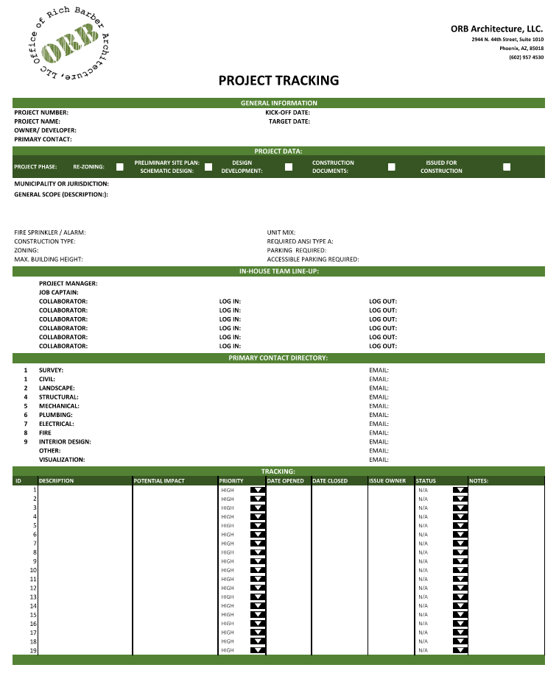
ORB REVIT UPDATES
ORB PROGRAMS
PROJECT SUBMITTAL TRACKER
PROJECT TRACKER
LICENSING GOALS
EMPLOYEE RECOGNITION PROGRAM
QA / QC EVALUATIONS AT EACH PROJECT PHASE
CONSULTANT CHECKLISTS
TWINMOTION RENDERINGS
SITE PLAN MARKETING PLANS
ON-GOING TRAINING & GUEST SPEAKERS
Notes:
THE LEADERSHIP TEAM HAS BEEN PROVIDING GREAT FEEDBACK AS WELL AS NEW AND IMPROVED WORKFLOWS. A PROJECT SUBMITTAL TRACKER TO PROVIDE ANYONE WITH THE HISTORY OF A PROJECT AS IT GOES THROUGH THE SUBMITTAL PROCESS. BECAUSE THESE PROJECTS CAN LAST SEVERAL YEARS, THIS PROVIDES A RECORD OF WHY THE PROJECT HAS TAKEN THOSE MEASURES OR DEVIATIONS FROM THE STANDARD NORMS – SPEAR HEADED BY RICHARD

Slide 10
ORB REVIT UPDATES
ORB PROGRAMS
PROJECT SUBMITTAL TRACKER
PROJECT TRACKER
LICENSING GOALS
EMPLOYEE RECOGNITION PROGRAM
QA / QC EVALUATIONS AT EACH PROJECT PHASE
CONSULTANT CHECKLISTS
TWINMOTION RENDERINGS
SITE PLAN MARKETING PLANS
ON-GOING TRAINING & GUEST SPEAKERS
Notes:
THE PROJECT TRACKER PROVIDES MORE IN-DEPTH INFORMATION ON THE EVOLUTION OF THE PROJECT INTERNALLY. SINCE MANY PEOPLE JUMP FROM PROJECT TO PROJECT, THIS CREATES A TIME LINE OF MAJOR CHANGES AND DECISIONS THAT HAVE TAKEN PLACE – SPEARHEADED BY JHON

Slide 11
ORB REVIT UPDATES
ORB PROGRAMS
PROJECT SUBMITTAL TRACKER
PROJECT TRACKER
LICENSING GOALS
EMPLOYEE RECOGNITION PROGRAM
QA / QC EVALUATIONS AT EACH PROJECT PHASE
CONSULTANT CHECKLISTS
TWINMOTION RENDERINGS
SITE PLAN MARKETING PLANS
ON-GOING TRAINING & GUEST SPEAKERS
Notes:
ORB STILL PROVIDES THE BLACK SPECTACLES PROGRAM FOR THOSE TO WANT TO PURSUE THEIR REGISTRATION. THIS IS AVAILABLE TO WHOEVER NEEDS IT. WE ENCOURAGE YOU TO USE IT – TAKEN OVER BY THEO

Slide 12
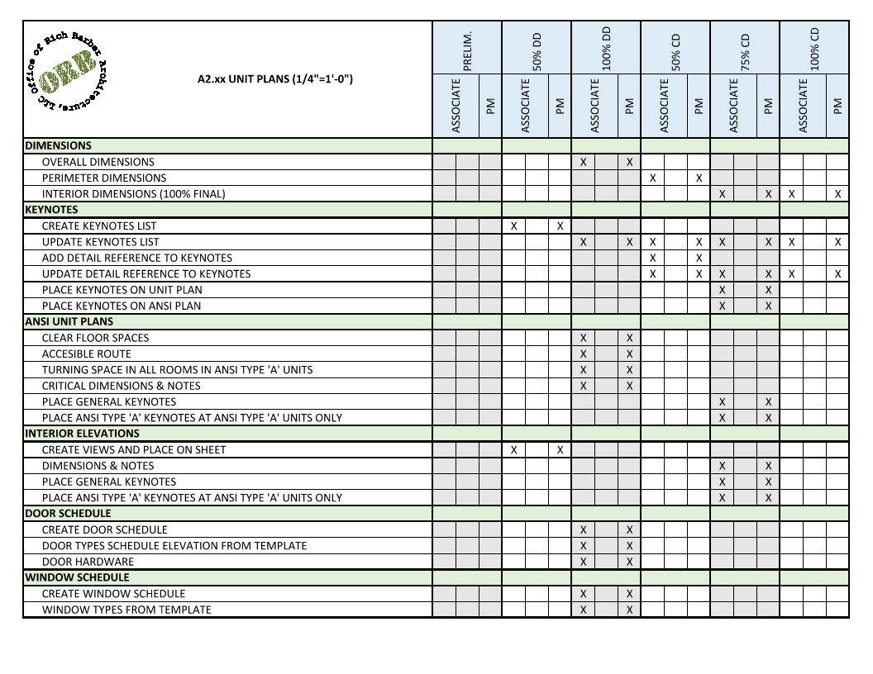
ORB REVIT UPDATES
ORB PROGRAMS
PROJECT SUBMITTAL TRACKER
PROJECT TRACKER
LICENSING GOALS
EMPLOYEE RECOGNITION PROGRAM
QA / QC EVALUATIONS AT EACH PROJECT PHASE
CONSULTANT CHECKLISTS
TWINMOTION RENDERINGS
SITE PLAN MARKETING PLANS
ON-GOING TRAINING & GUEST SPEAKERS
Notes:
THERE WILL BE AN EMPLOYEE RECOGNITION PROGRAM TO PROVIDE JUST CREDIT TO THE PEOPLE IN ORB WHO ARE GOING ABOVE AND BEYOND – SPEARHEADED BY GONZALO

Slide 13
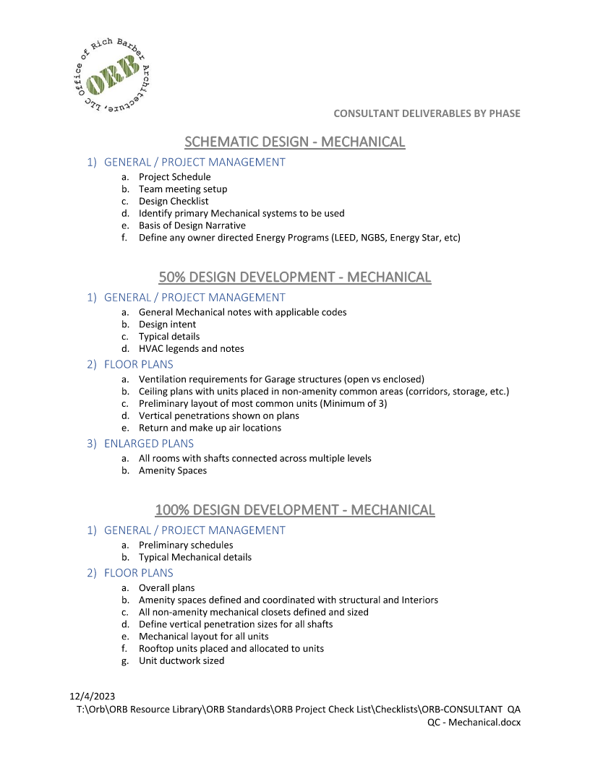
ORB REVIT UPDATES
ORB PROGRAMS
PROJECT SUBMITTAL TRACKER
PROJECT TRACKER
LICENSING GOALS
EMPLOYEE RECOGNITION PROGRAM
QA / QC EVALUATIONS AT EACH PROJECT PHASE
CONSULTANT CHECKLISTS
TWINMOTION RENDERINGS
SITE PLAN MARKETING PLANS
ON-GOING TRAINING & GUEST SPEAKERS
Notes:
QA / QC PROCEDURES ARE SET IN PLACE. EACH PROJECT PHASE WILL HAVE ARCHITECTURAL AND MODEL HEALTH CHECKS TO ENSURE THE PROJECT RUNS SMOOTHLY AND DRAWINGS ARE DONE ACCORDING TO THE ORB STANDARDS – BY ORB MANAGEMENT

Slide 14
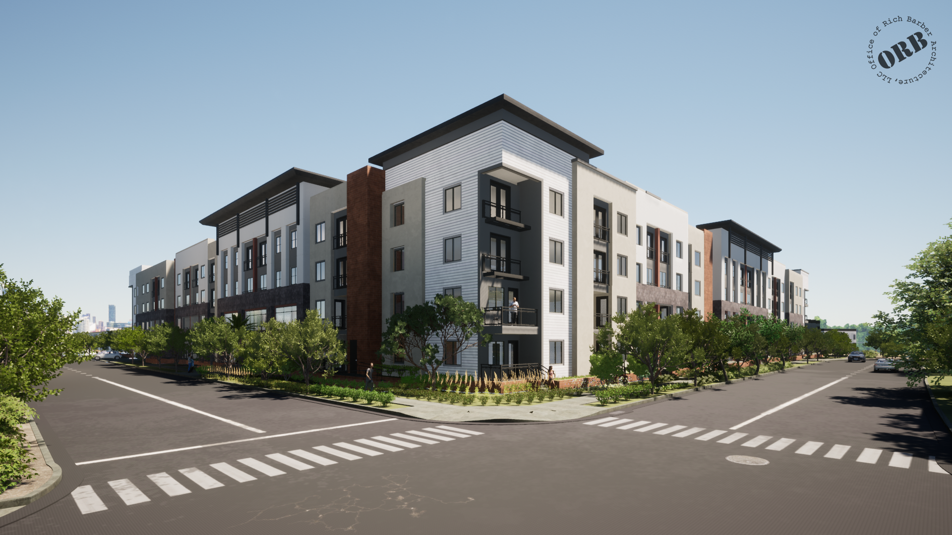
ORB REVIT UPDATES
ORB PROGRAMS
PROJECT SUBMITTAL TRACKER
PROJECT TRACKER
LICENSING GOALS
EMPLOYEE RECOGNITION PROGRAM
QA / QC EVALUATIONS AT EACH PROJECT PHASE
CONSULTANT CHECKLISTS
TWINMOTION RENDERINGS
SITE PLAN MARKETING PLANS
ON-GOING TRAINING & GUEST SPEAKERS
Notes:
WE ARE NOT ONLY HOLDING OURSELVES ACCOUNTABLE. WE ARE ALSO ASKING OUR CONSULTANTS TO BE ACCOUNTABLE. WE HAVE DOCUMENTS PREPARED THAT WILL BE PROVIDED TO CONSULTANTS SO BOTH THEY AND ORB KNOW WHAT IS EXPECTED OF EVERYONE AND AT WHICH STAGE – BY ORB MANAGEMENT

Slide 15
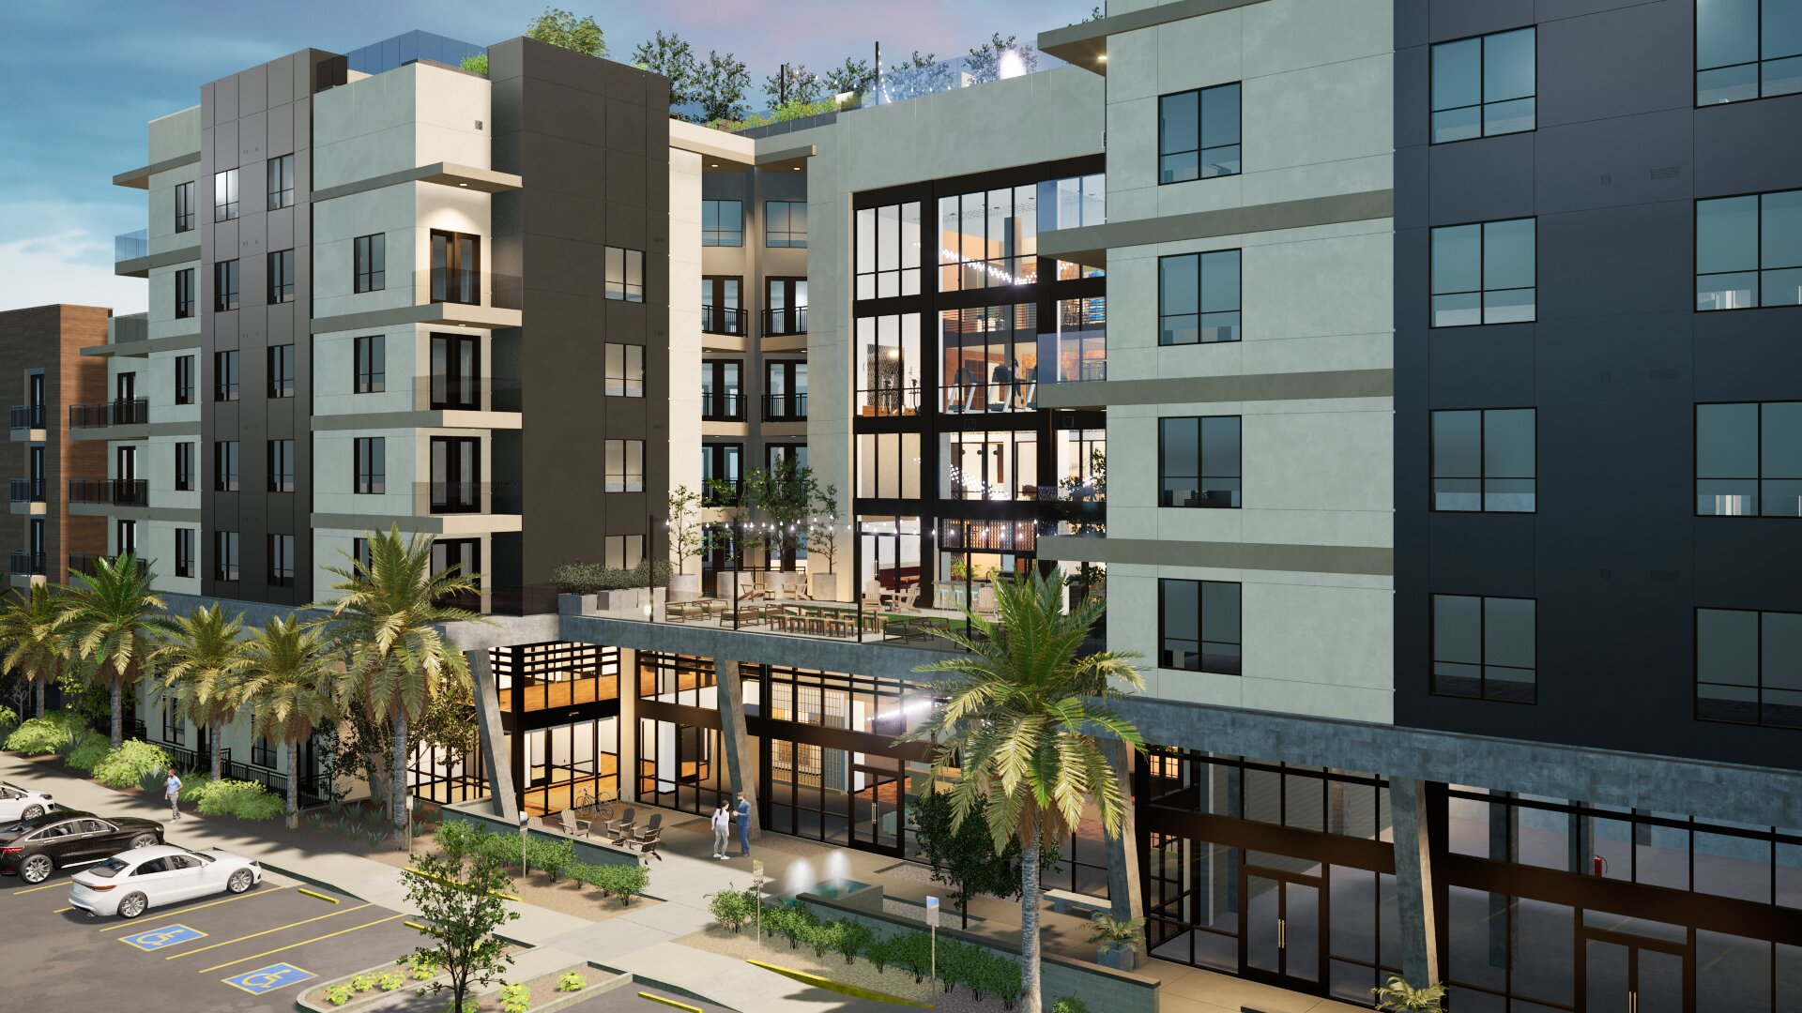
ORB REVIT UPDATES
ORB PROGRAMS
PROJECT SUBMITTAL TRACKER
PROJECT TRACKER
LICENSING GOALS
EMPLOYEE RECOGNITION PROGRAM
QA / QC EVALUATIONS AT EACH PROJECT PHASE
CONSULTANT CHECKLISTS
TWINMOTION RENDERINGS
SITE PLAN MARKETING PLANS
ON-GOING TRAINING & GUEST SPEAKERS
Notes:
AFTER PROVIDING A REVIT UNIVERSITY SESSION ON TWINMOTION, SOME OF OUR COLEGUES HAVE DONE SOME AMAZING RENDERS THAT WILL BE USED FOR MARKETING PURPOSES

Slide 16
ORB REVIT UPDATES
ORB PROGRAMS
PROJECT SUBMITTAL TRACKER
PROJECT TRACKER
LICENSING GOALS
EMPLOYEE RECOGNITION PROGRAM
QA / QC EVALUATIONS AT EACH PROJECT PHASE
CONSULTANT CHECKLISTS
TWINMOTION RENDERINGS
SITE PLAN MARKETING PLANS
ON-GOING TRAINING & GUEST SPEAKERS
Notes:
NOW ORB IS ABLE TO PROVIDE NEW SERVICES IF NEEDED AND GIVE CLIENTS A RENDERING THAT IS MUCH CLOSER TO THE FINISH PRODUCT. – BY GABBY, MIGUEL & JENNIFER

Slide 17
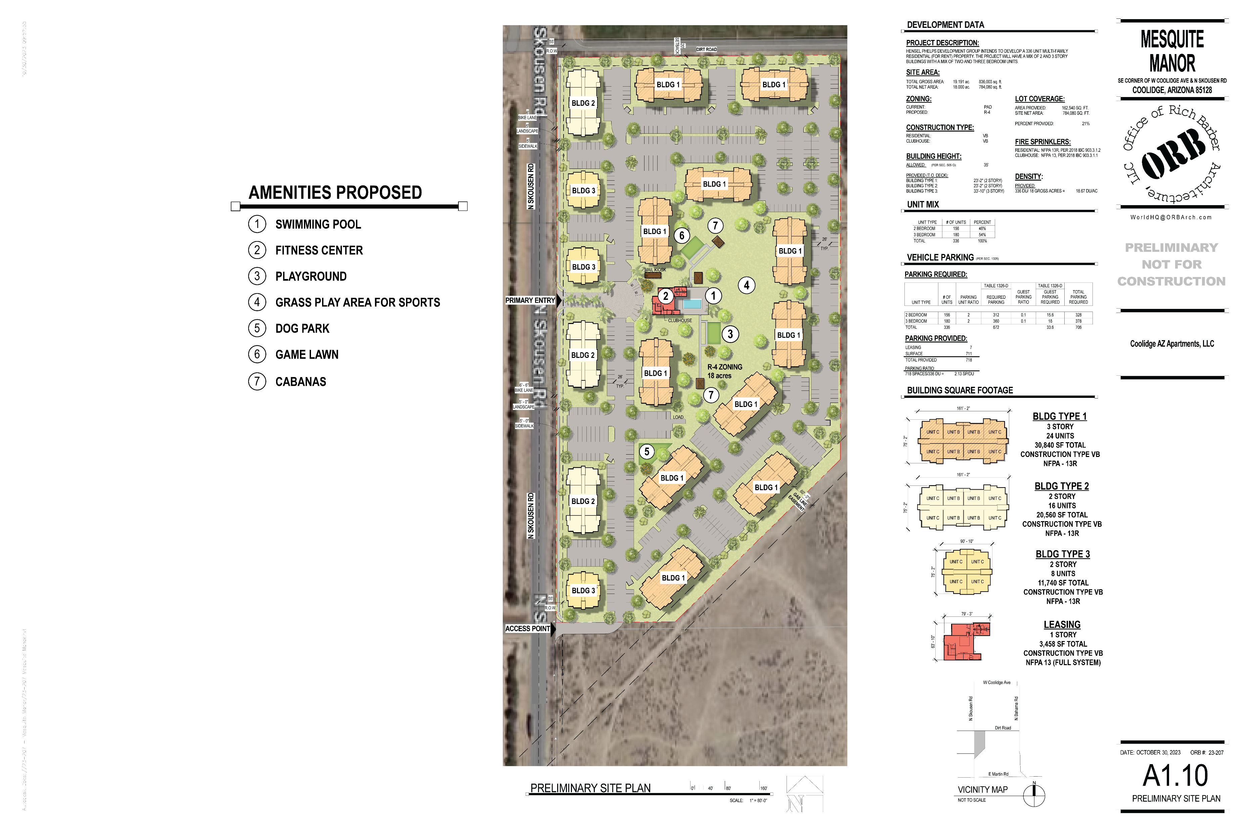
ORB REVIT UPDATES
ORB PROGRAMS
PROJECT SUBMITTAL TRACKER
PROJECT TRACKER
LICENSING GOALS
EMPLOYEE RECOGNITION PROGRAM
QA / QC EVALUATIONS AT EACH PROJECT PHASE
CONSULTANT CHECKLISTS
TWINMOTION RENDERINGS
SITE PLAN MARKETING PLANS
ON-GOING TRAINING & GUEST SPEAKERS

Slide 18
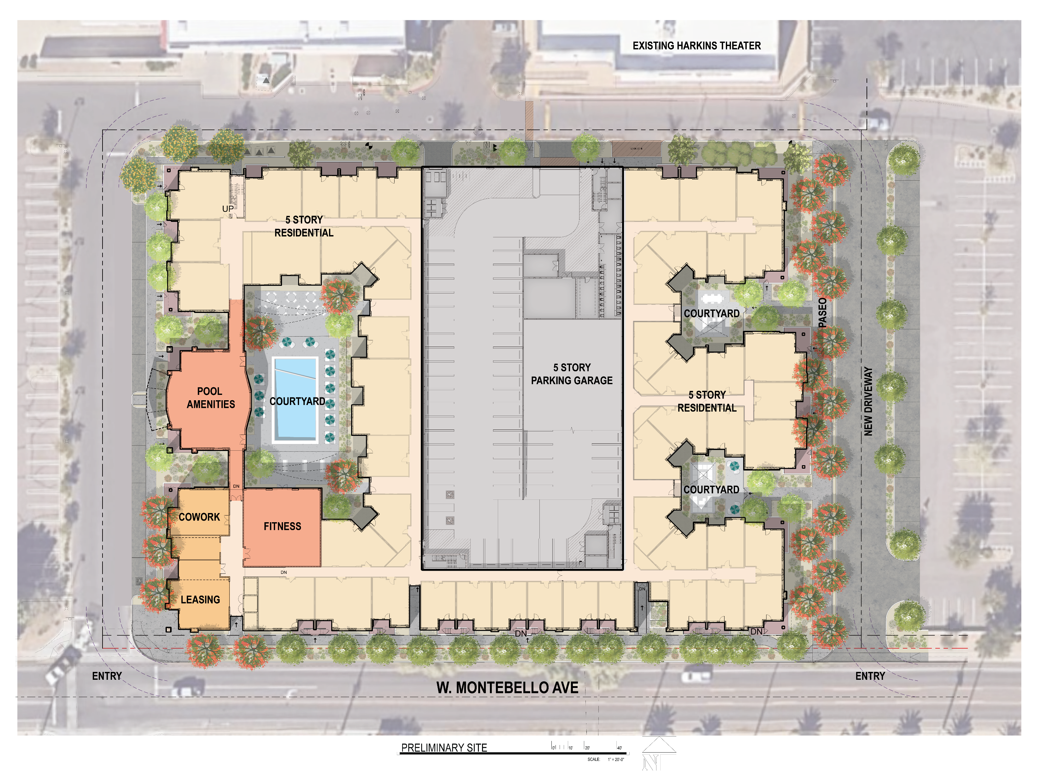
ORB REVIT UPDATES
ORB PROGRAMS
PROJECT SUBMITTAL TRACKER
PROJECT TRACKER
LICENSING GOALS
EMPLOYEE RECOGNITION PROGRAM
QA / QC EVALUATIONS AT EACH PROJECT PHASE
CONSULTANT CHECKLISTS
TWINMOTION RENDERINGS
SITE PLAN MARKETING PLANS
ON-GOING TRAINING & GUEST SPEAKERS
Notes:
RIKKIE HAS BEEN HARD AT WORK CREATING MARKETING SITE PLANS, THESE ARE NOT ONLY PROVIDED TO THE CITY AT THE TIME OF SUBMITTAL, BUT ANY PROSPECTIVE CLIENTS COMING IN, WILL NOW HAVE A BETTER UNDERSTANDING OF WHAT THEY CAN EXPECT FROM ORB AND WHAT IS NOW SETTING US APPART FROM THE COMPETITION

Slide 19
ORB REVIT UPDATES
ORB PROGRAMS
PROJECT SUBMITTAL TRACKER
PROJECT TRACKER
LICENSING GOALS
EMPLOYEE RECOGNITION PROGRAM
QA / QC EVALUATIONS AT EACH PROJECT PHASE
CONSULTANT CHECKLISTS
TWINMOTION RENDERINGS
SITE PLAN MARKETING PLANS
ON-GOING TRAINING & GUEST SPEAKERS

Slide 20
ORB REVIT UPDATES
ORB PROGRAMS
PROJECT SUBMITTAL TRACKER
PROJECT TRACKER
LICENSING GOALS
EMPLOYEE RECOGNITION PROGRAM
QA / QC EVALUATIONS AT EACH PROJECT PHASE
CONSULTANT CHECKLISTS
TWINMOTION RENDERINGS
SITE PLAN MARKETING PLANS
ON-GOING TRAINING & GUEST SPEAKERS
Notes:
ORB WILL CONTINUE TO PROVIDE TRANING THROUGH ORB/REVIT UNIVERSITY. WE ARE INVITING GUEST SPEAKERS AND ASKING OTHERS IN THE OFFICE TO PROVIDE THEIR EXPERIENCE AND EXPERTISE IN DIFFERENT ARCHITECTURAL FIELDS. THE DOOR IS OPEN IF YOU WANT TO COVER A TOPIC OR IF YOU WOULD LIKE TO REVIEW OTHER ASPECS, SUCH AS CONSTRUCTION METHODOLOGY OR CODES

Slide 21
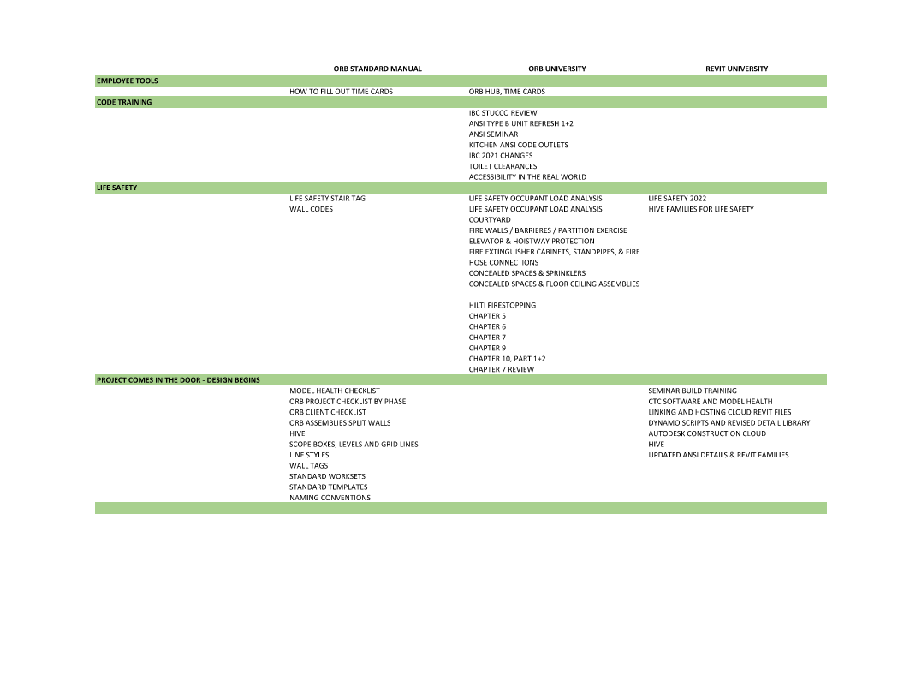
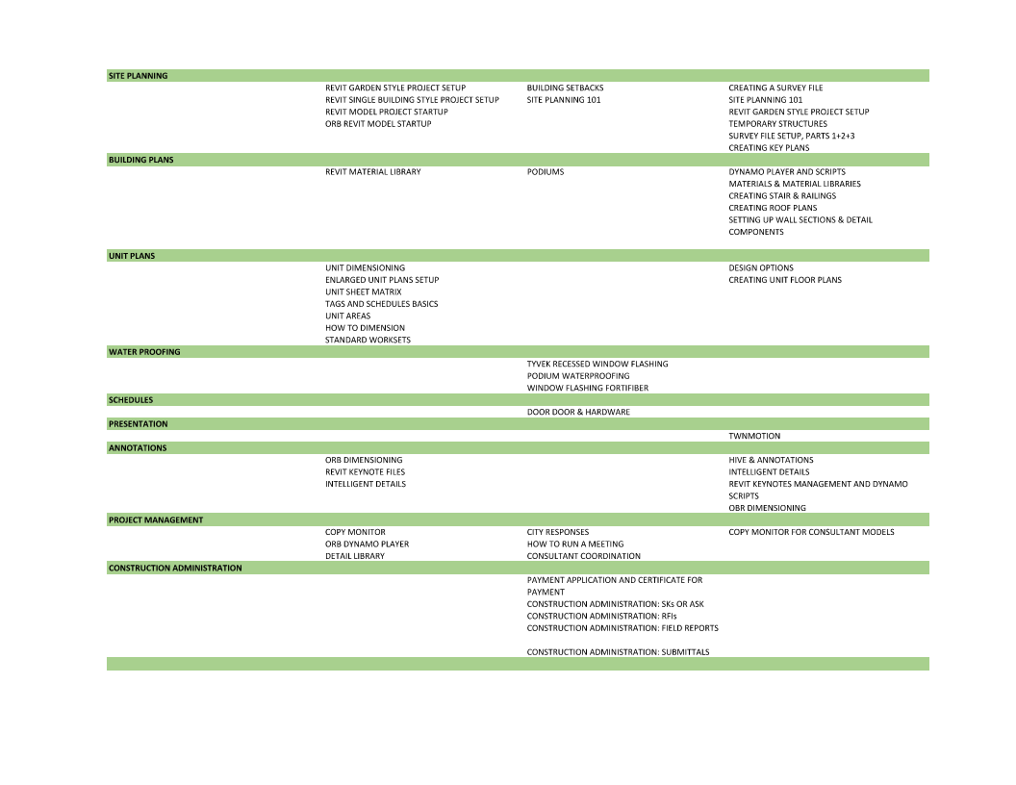
ORB PROJECTS
PRELIMINARY:
TEMPORARY STRUCTURES
SCHEDULED MEETING WITH RAA + ARF + PROJECT MANAGER
EXPECTATIONS
SCOPE
SCALE
DEVIATIONS FROM STANDARDS IF NECESSARY
TYPICAL UNITS ALREADY IN TEMPLATE
RESOURCES: RICH, TIM
REVIT / ORB UNIVERSITIES & MANUALS
REVISED FAMILIES
Notes:
MIGUEL HAS ADDED THE ORB RESOURCE INDEX TO THE HUB. THE EXISTING ORB / REVIT UNIVERSITIES AND MANUALS ARE SHOW HERE TO SHOW YOU ALL THE TOOLS YOU HAVE AVAILABLE TO YOU DEPENDING ON THE TYPE OF WORK YOU WILL BE DOING
PROCESS FOR TYPICAL PROJECT:::

Slide 22
ORB PROJECTS
50% DESIGN DEVELOPMENT:
LIFE SAFETY – BLUEBEAM TOOLS
PRE-SET STANDARDS FOR DOORS, WINDOWS, WALLS, ASSEMBLIES, ETC
PARAMETERS SET TO VIEW TEMPLATES
SPLIT WALL SYSTEM FOR MODELING EXTERIOR WALLS
DYNAMO TOOLS TO CREATE VIEWS & SHEETS AUTOMATICALLY
RESOURCES: ANDRES, RICHARD
REVIT / ORB UNIVERSITIES & MANUALS
REVISED FAMILIES
MODEL HEALTH AUDIT
CHECKLIST REVIEW

Slide 23
ORB PROJECTS
100% DESIGN DEVELOPMENT:
LIFE SAFETY CHAPTERS – ORB UNIVERSITY
REVIEWED GENERAL NOTES
MATERIAL LIBRARY SET
USE OF DYNAMO FOR NEW UNITS
DIMENSIONING GUIDELINES IN HUB
ANSI RESOURCES – GONZALO + THEO
REVIT / ORB UNIVERSITIES & MANUALS
REVISED FAMILIES
MODEL HEALTH AUDIT
CHECKLIST REVIEW

Slide 24
ORB PROJECTS
50% CONSTRUCTION DOCUMENTS:
INFORMATION IS FRONT LOADED FOR YOU
DOORS, WINDOWS, WALLS, FIRE RATING, FAMILIES, AREA PLANS
USE OF ELEMENT KEYNOTES
RESOURCES: ANDRES, RICHARD
REVIT / ORB UNIVERSITIES & MANUALS
REVISED FAMILIES
MODEL HEALTH AUDIT
CHECKLIST REVIEW

Slide 25
ORB PROJECTS
75% CONSTRUCTION DOCUMENTS:
INFORMATION IS FRONT LOADED FOR YOU
DOORS, WINDOWS, WALLS, FIRE RATING, FAMILIES, AREA PLANS
KEYNOTES
ELEMENT
USER
900 SERIES
RESOURCES: RICHARD
REVIT / ORB UNIVERSITIES & MANUALS
REVISED FAMILIES
MODEL HEALTH AUDIT
CHECKLIST REVIEW

Slide 26
ORB PROJECTS
100% CONSTRUCTION DOCUMENTS:
TAGS + TAGS + TAGS
DIMENSIONS
RESOURCES: RICHARD
REVIT / ORB UNIVERSITIES & MANUALS
REVISED FAMILIES
MODEL HEALTH AUDIT
CHECKLIST REVIEW

Slide 27
ORB PROJECTS
CONSTRUCTION ADMINISTRATION:
BLUEBEAM TOOLS
CA ADMINISTRATOR
RESOURCES: ANN, CLIFF, DAVID, CARLOS
REVIT / ORB UNIVERSITIES & MANUALS

Slide 28
ORB PROJECTS
AND STILL MORE TO COME

